Slide 1
ASSALAM O ALIKUM EVERONE
HOW ARE YOU
MY NAME IS MALIK

Slide 2
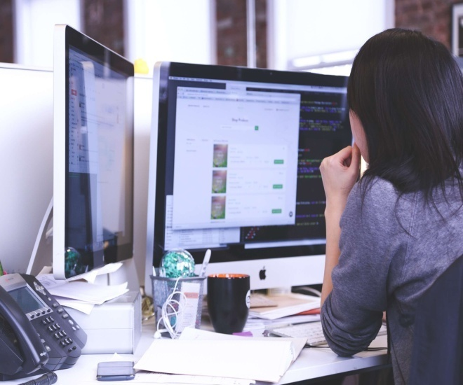
BASIC COMPUTER COURSE
WHAT IS COMPUTER ?
TYPES OF COMPUTER ?
Hardware & software ?

Slide 3

What is computer ?
A computer is an electronic
device That can store and
retriee data

Slide 4

Hardware & Software
Hardware: * The physical part of
Computer is called hardware.
Software: * A set of program is
called Software.

